Slide 1
2. Network Models
Sharada Valiveti
Chandan Trivedi
Parita Oza
Umesh Bodkhe

Slide 2
Disclaimer All illustrations and diagrams are taken from the same book. Existing Power-point presentations by the same author are used in creating new presentations

Slide 3
Outline
Concept of Protocol Layering
Scenarios
Principles of Protocol Layering
Logical Connections
Layers of the TCP/IP Protocol Suite
Layered Architecture
Layers and Description
Encapsulation and Decapsulation
Addressing
Multiplexing and Demultiplexing
OSI Model
OSI Versus TCP/IP
Lack of OSI Model’s Success

Slide 4
Protocol Layering
Scenarios
Principles
Logical Connections

Slide 5
Protocol Layering: Scenarios
In communication and networking, protocol defines the rules that all communicating parties must follow
Communicating parties include
Sender
Receiver
Intermediate devices
Simple communication may need only one simple protocol
Complex communication needs to divide tasks between different layers
So need a protocol at each layer
Protocol layering

Slide 6
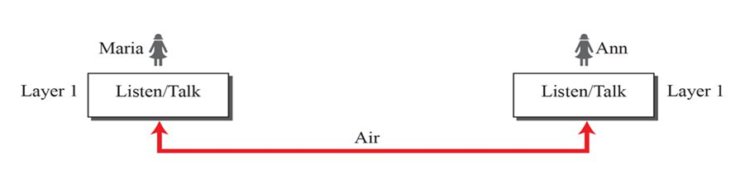
A single-layer protocol
Set of rules Maria and Ann would follow:
Greet each other when they meet
Know that they should confine their vocabulary to the level of their friendship
Refrain from speaking when the other party is speaking
Conversation should be a dialog
Exchange some nice words when they leave

Slide 7
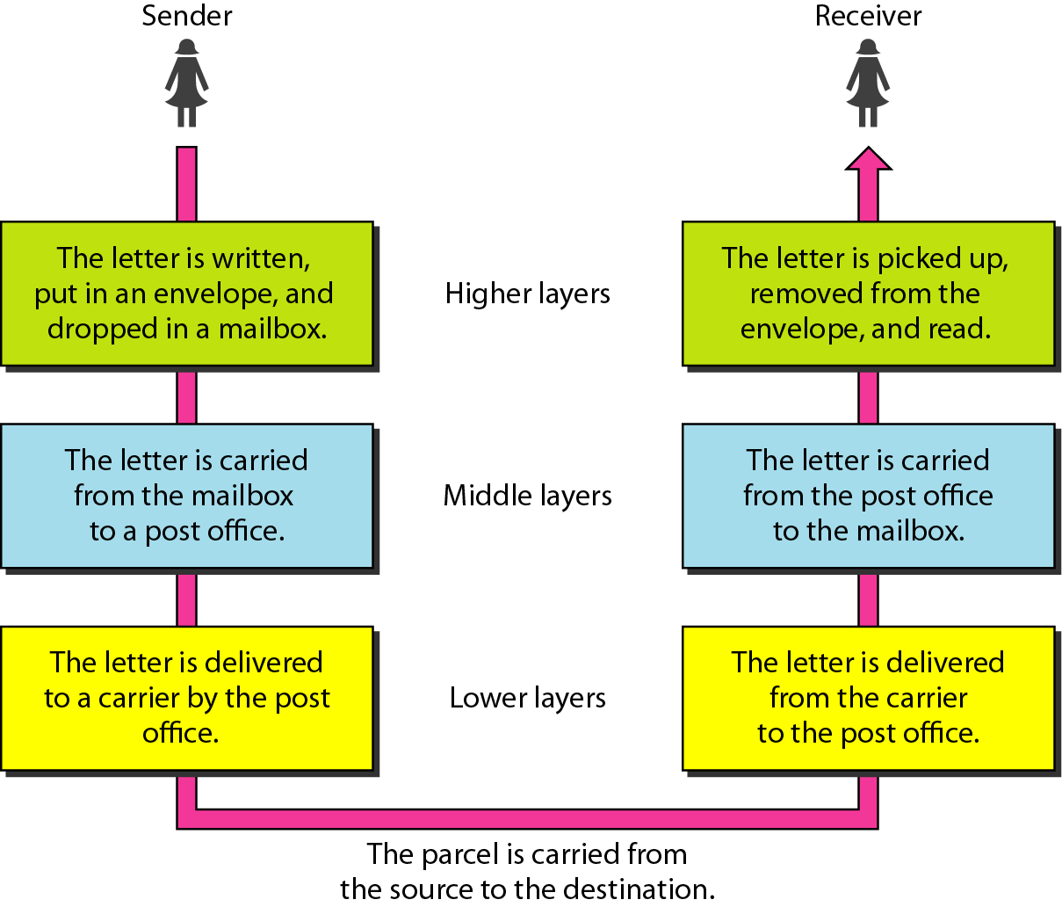
Protocol Layering used in postal communication as an example

Slide 8
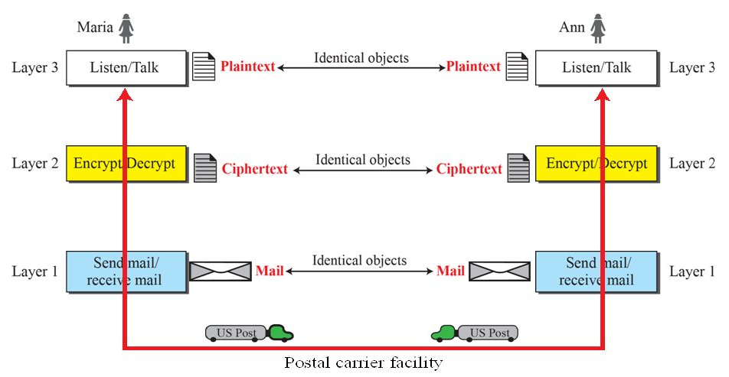
A three-layer protocol

Slide 9
Protocol Layering: Scenarios
Enables us to divide a complex task into several smaller and simpler tasks
Modular implementation (Modularity) enables layered replacements only
Layer is black box with inputs and outputs, without concern about how inputs are changed to outputs
If two machines provide the same outputs when given the same inputs, they can replace each other
Advantages:
Separate services from implementation
Layer receives set of services from lower layer and give services to the upper layer
Intermediate devices may need only some layers, but not all layers

Slide 10
Protocol layering: Principles of Protocol Layering
First Principle
Bidirectional communication needs to make each layer so that it is able to perform two opposite tasks, one in each direction
Second Principle
Two objects under each layer at both sites should be identical

Slide 11
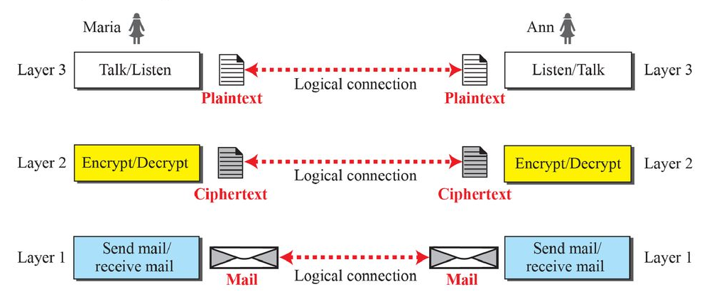
Protocol Layering: Logical Connections

Slide 12
TCP/IP Protocol Suite
Layered Architecture
Layers in TCP/IP Protocol Suite
Description of Each Layer
Encapsulation and Decapsulation
Addressing
Multiplexing and Demultiplexing

Slide 13
TCP/IP Protocol Suite: Layered Architecture
Transmission Control Protocol / Internet Protocol (TCP/IP)
Protocol suite used in the Internet today
Hierarchical protocol made up of interactive modules, each of which provides a specific functionality
Each upper level protocol is supported by the services provided by one or more lower level protocols
Original TCP/IP protocol suite was defined as four software layers built upon the hardware
Host-to-network, internet, transport and application
Today, TCP/IP is thought of as a five-layer model

Slide 14
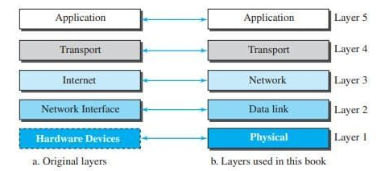
TCP/IP Protocol Suite

Slide 15
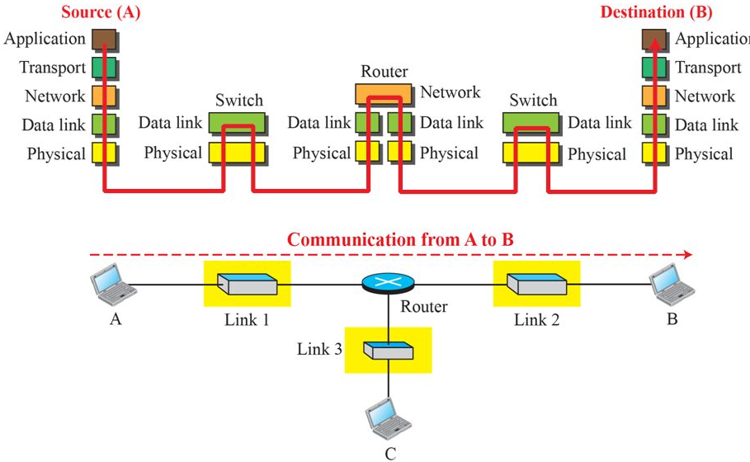
Communication through an Internet

Slide 16
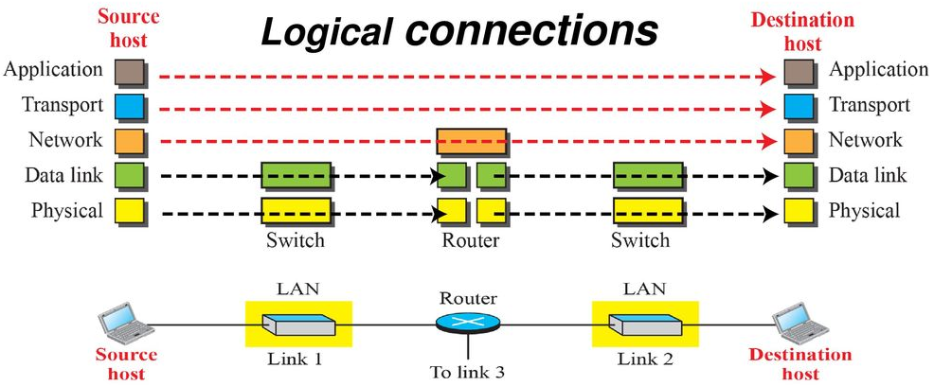
TCP/IP Protocol Suite: Layers in the TCP/IP Protocol Suite
Logical connections between layers of the TCP/IP protocol suite

Slide 17
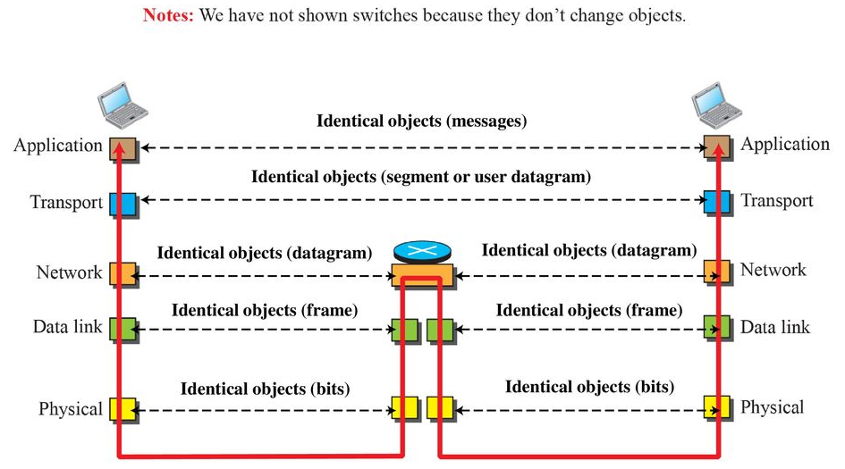
Identical objects in the TCP/IP Protocol Suite

Slide 18
TCP/IP Protocol Suite: Description of each Layer
Physical Layer
Responsible for carrying individual bits in a frame across the link
At Physical Layer, communication is logical communication as
There is another hidden layer, the transmission medium – transmits signals
Bits received in a frame from data-link layer are transformed and sent through the transmission media
Several protocols transform bits to a signal

Slide 19
TCP/IP Protocol Suite: Description of each Layer
Data-link Layer
Internet is made up of several links (LANs and WANs) connected by routers
Overlapping sets of links between host and destination
Routers choose best links
Data-link layer takes the datagram and moves it across the link using various protocols for the specific type of link
Takes a datagram and encapsulates it in a packet called a frame
Link layer provides complete error detection and correction or only error correction

Slide 20
TCP/IP Protocol Suite: Description of each Layer
Network Layer
Responsible for creating a connection between source computer and destination computer
Communication is host-to-host
Separate network layer to have modular implementation
Internet Protocol
Routing
defines format of datagram, structure of addresses and routes packet from source to destination
Connectionless protocol
No flow control, error control and congestion control

Slide 21
TCP/IP Protocol Suite: Description of each Layer
Network Layer
Includes unicast and multicast routing protocols
Creates forwarding tables for routers to help them in routing process
Other protocols that help IP in delivery
Internet Control Message Protocol (ICMP) helps IP to report some problems when routing a packet
Internet Group Management Protocol (IGMP) helps IP in multicasting
Dynamic Host Configuration Protocol (DHCP) helps IP to get network-layer network layer address for a host
Address Resolution Protocol (ARP) helps IP to find link layer address of a host or router when its network layer address is given

Slide 22
TCP/IP Protocol Suite: Description of each Layer
Transport Layer (I/II)
Gets message from application program and deliver it to corresponding application program on the destination host
Independent of application layer
Transmission Control Protocol (TCP)
Connection oriented protocol
Establishes a logical connection between transport layers at two hosts before transferring data
Creates logical pipe between two TCPs for transferring stream of bytes
Provides Flow control, error control and congestion control

Slide 23
TCP/IP Protocol Suite: Description of each Layer
Transport Layer (II/II)
User Datagram Protocol (UDP)
Connectionless protocol
Transmits user datagrams without creating logical connection
Each datagram is independent entity
Does not provide flow, error or congestion control
Small overhead and hence applicable for sending short messages
Stream Control Transmission Protocol (SCTP)
Designed to respond to new applications emerging in multimedia

Slide 24
TCP/IP Protocol Suite: Description of each Layer
Application Layer
Communication between two processes
Process sends a request to other process and receives a response
Duty - Process to process communication
Hypertext Transfer Protocol (HTTP)
Vehicle for accessing World Wide Web
Simple Mail Transfer Protocol (SMTP)
Used in e-mail service
File Transfer Protocol (FTP)
Used for transferring files from one host to another

Slide 25
TCP/IP Protocol Suite: Description of each Layer
Application Layer
Terminal Network (TELNET) and Secure Shell (SSH)
Used for accessing a site remotely
Simple Network Management Protocol (SNMP)
Administrator uses to manage Internet at global and local levels
Domain Name System (DNS)
Used by other protocols to find the network-layer address of a computer
Internet Group Management Protocol
Collects membership in a group

Slide 26
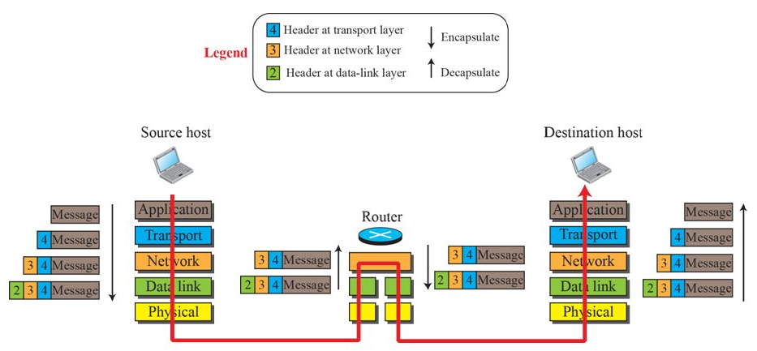
TCP/IP Protocol Suite: Encapsulation and Decapsulation
Encapsulation / Decapsulation

Slide 27
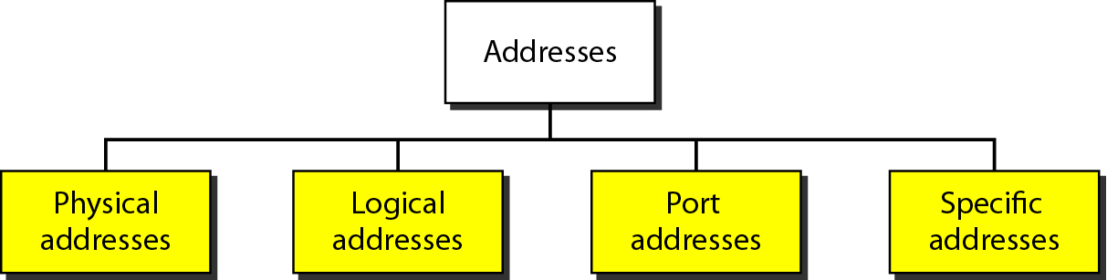
TCP/IP Protocol Suite: Addressing

Slide 28
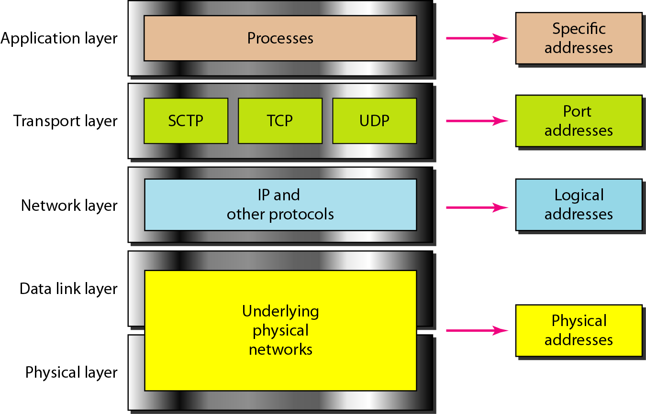
TCP/IP Protocol Suite: Addressing

Slide 29
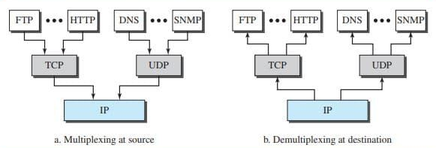
TCP/IP Protocol Suite: Multiplexing and Demultiplexing

Slide 30
The OSI Model
OSI Model
OSI Versus TCP/IP
Lack of OSI Model’s success

Slide 31
The OSI Model
International Organization for Standardization (ISO – established in 1947)
a multinational body
Dedicated to worldwide agreement on international standards
¾ of countries are represented in the ISO
ISO standard that covers all aspects of network communications is the Open System Interconnection (OSI) Model
Open system is set of protocols that allow any two different systems to communicate regardless of their underlying architecture
Shows how to facilitate communication between different systems without requiring changes to the logic of underlying hardware and software
Basis for creation of protocols in the OSI stack
ISO is the organization. OSI is the model.

Slide 32
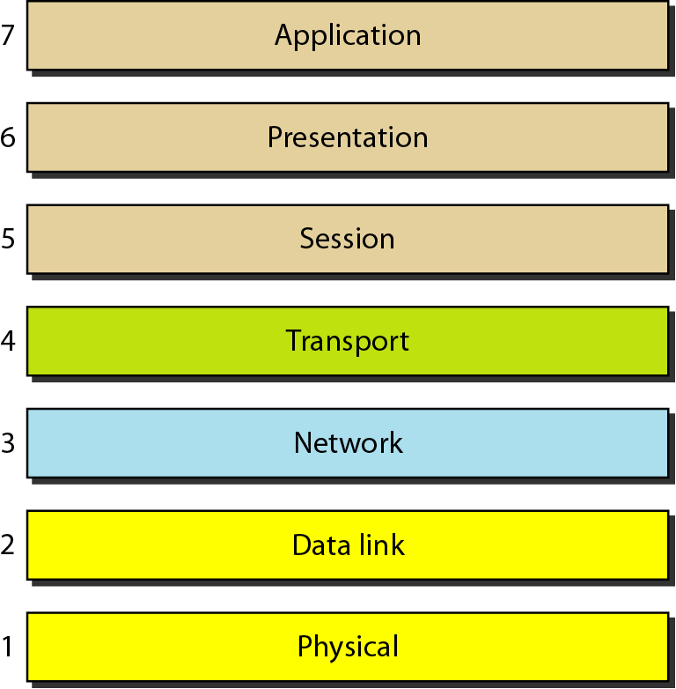
The OSI Model

Slide 33
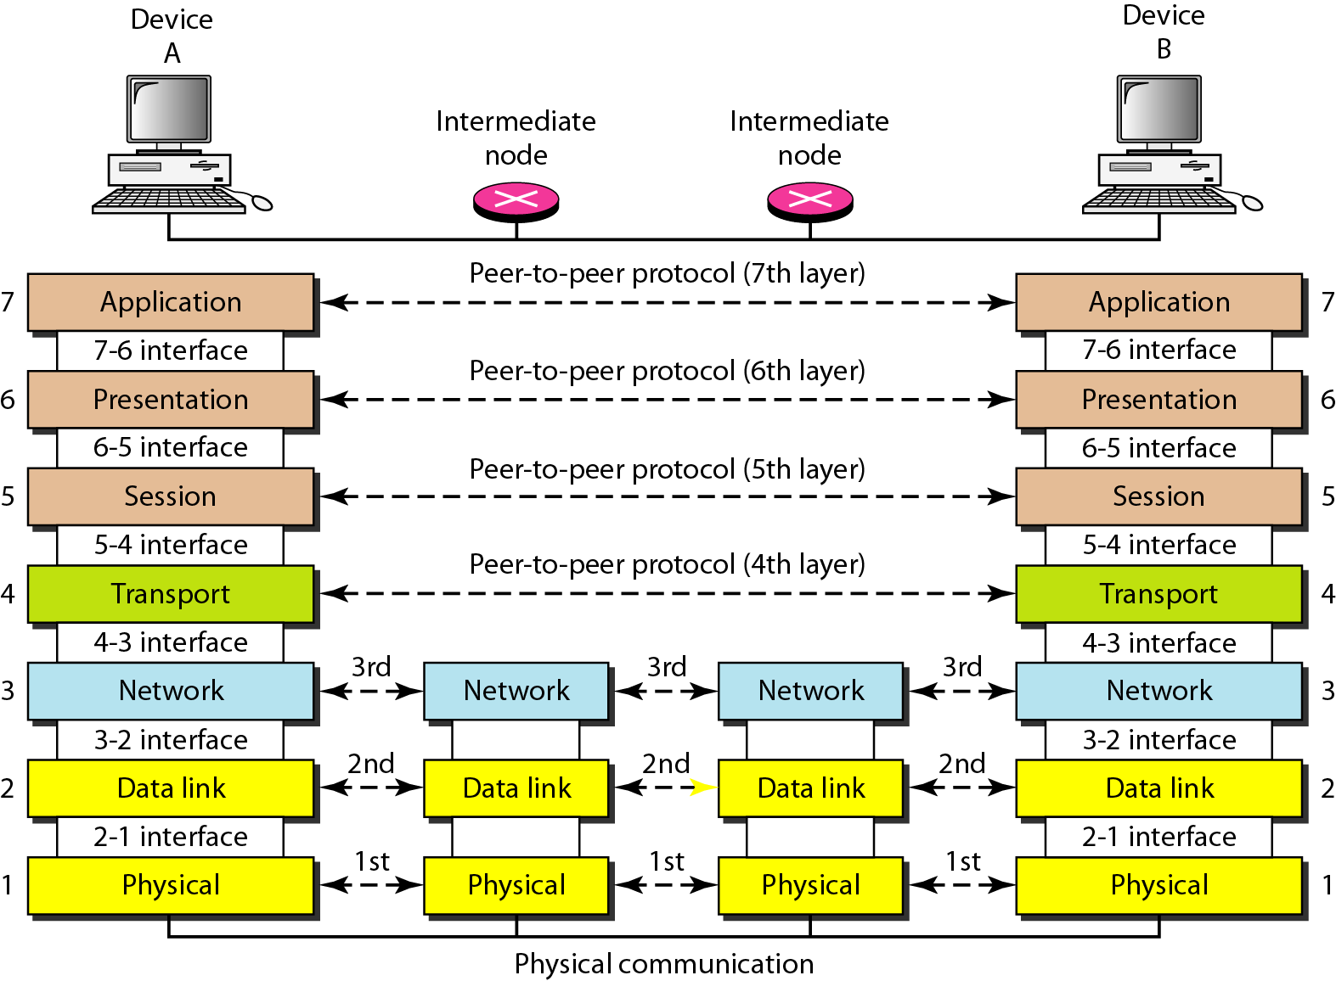
Interaction between layers in the OSI Model

Slide 34
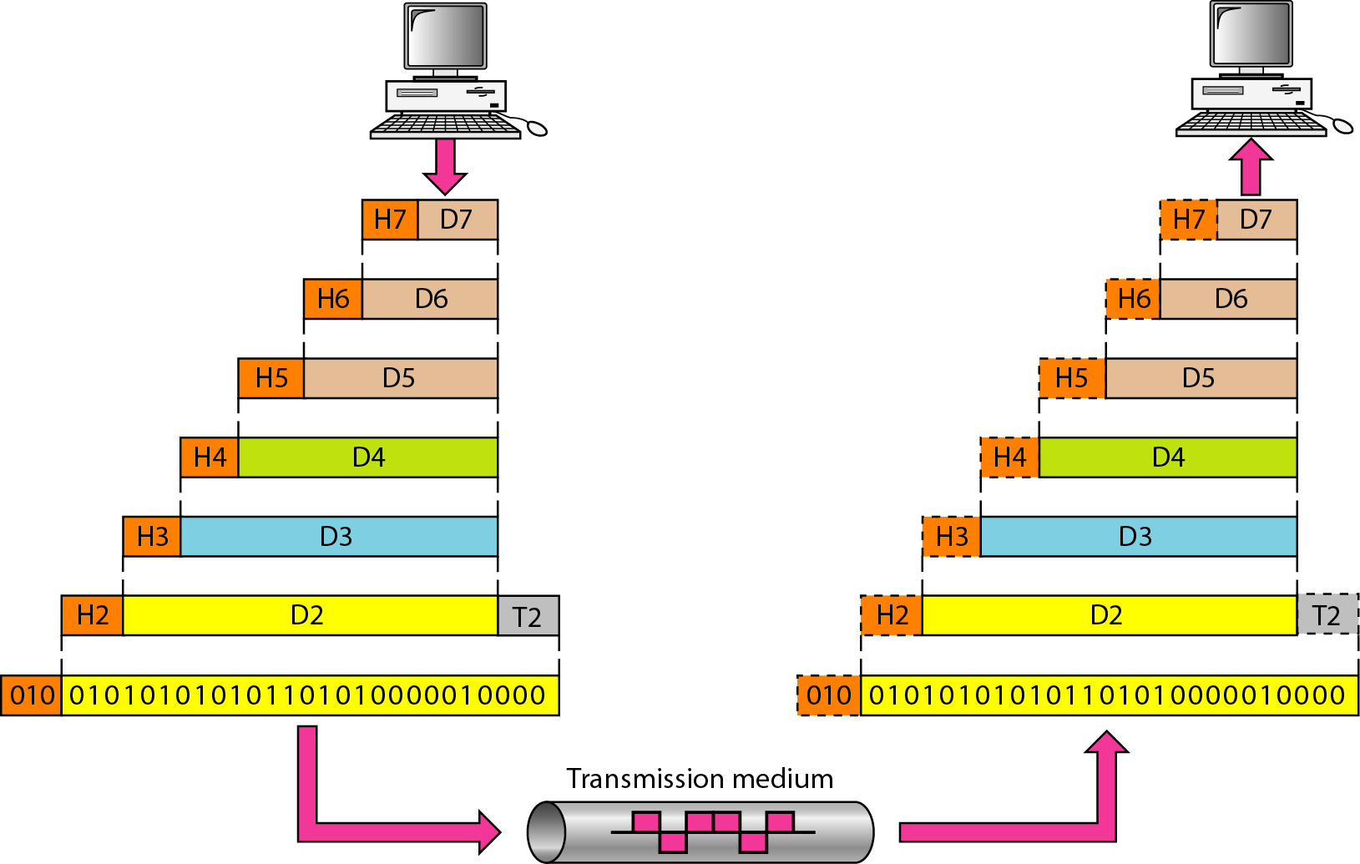
Exchange using OSI Model

Slide 35
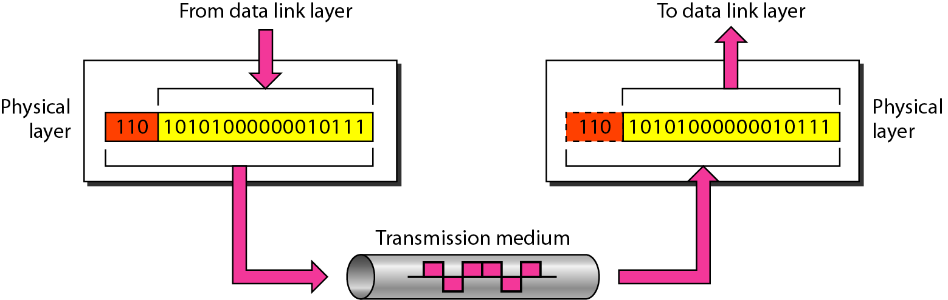
OSI Model: Layers: Physical Layer
The physical layer is responsible for movements of
individual bits from one hop (node) to the next.

Slide 36
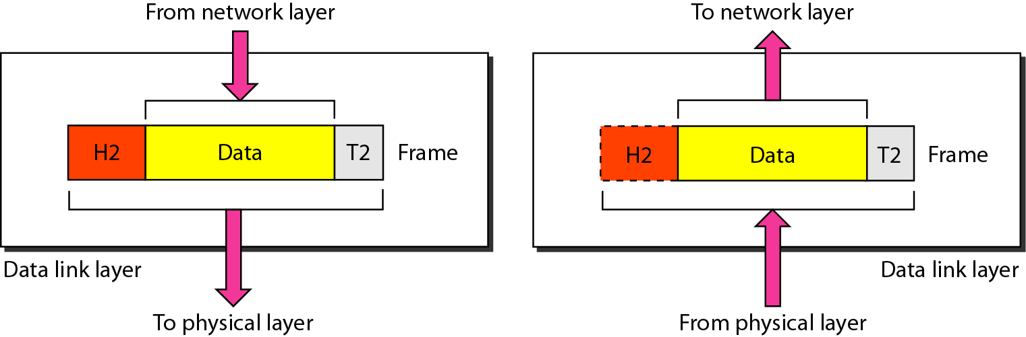
OSI Model: Layers: Datalink Layer
The data link layer is responsible for moving frames from one hop (node) to the next.

Slide 37
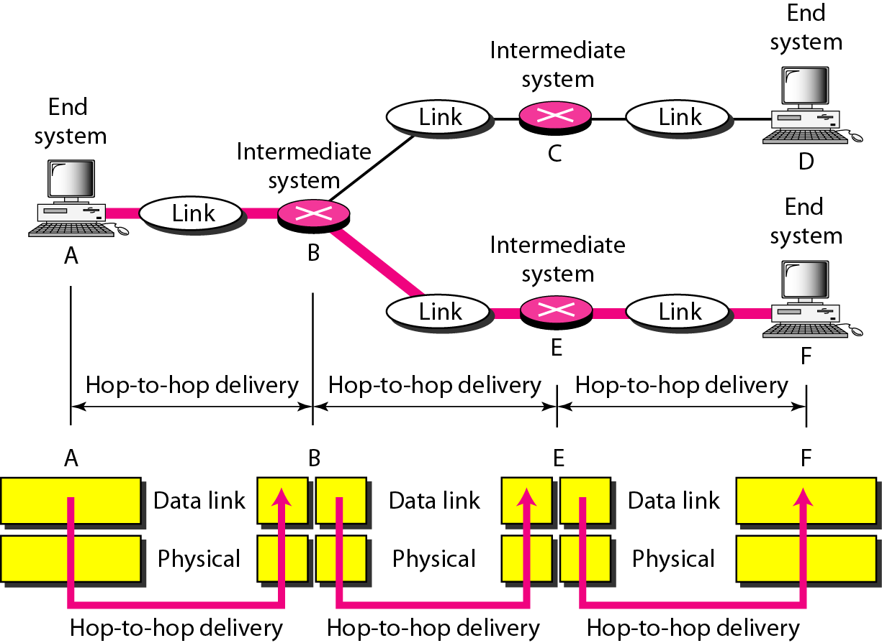
OSI Model: Layers: Datalink Layer
Hop-to-hop delivery

Slide 38
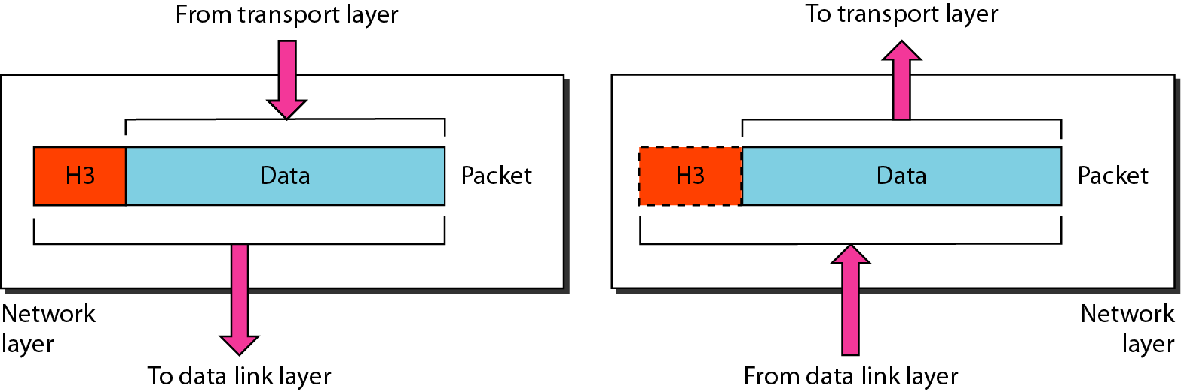
OSI Model: Layers: Network Layer
The network layer is responsible for the delivery of individual packets from
the source host to the destination host.

Slide 39
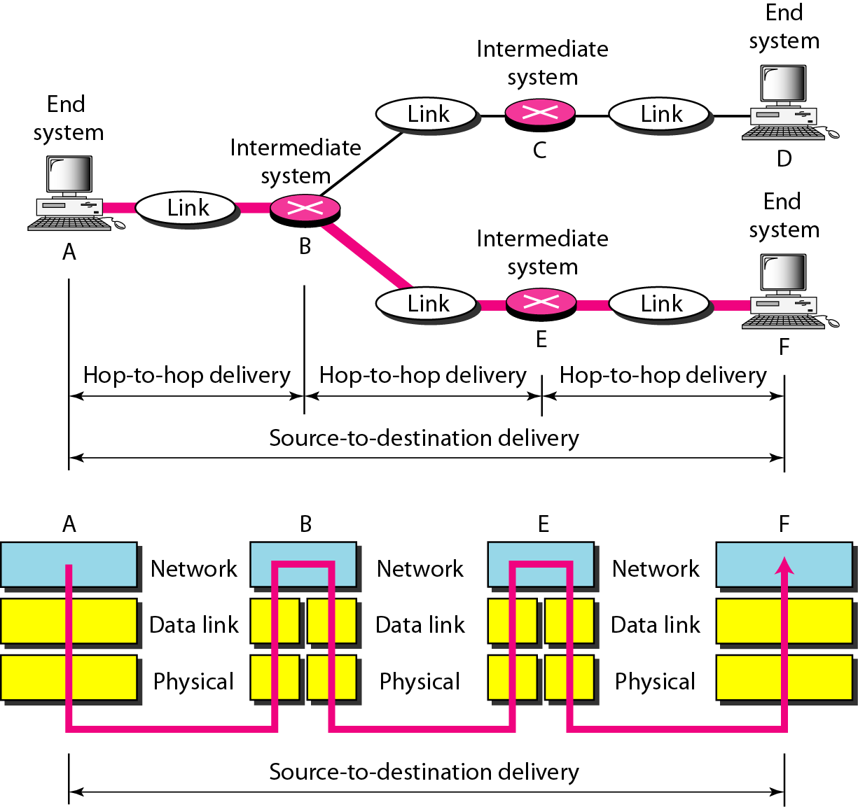
OSI Model: Layers: Network Layer
Source-to-destination delivery

Slide 40
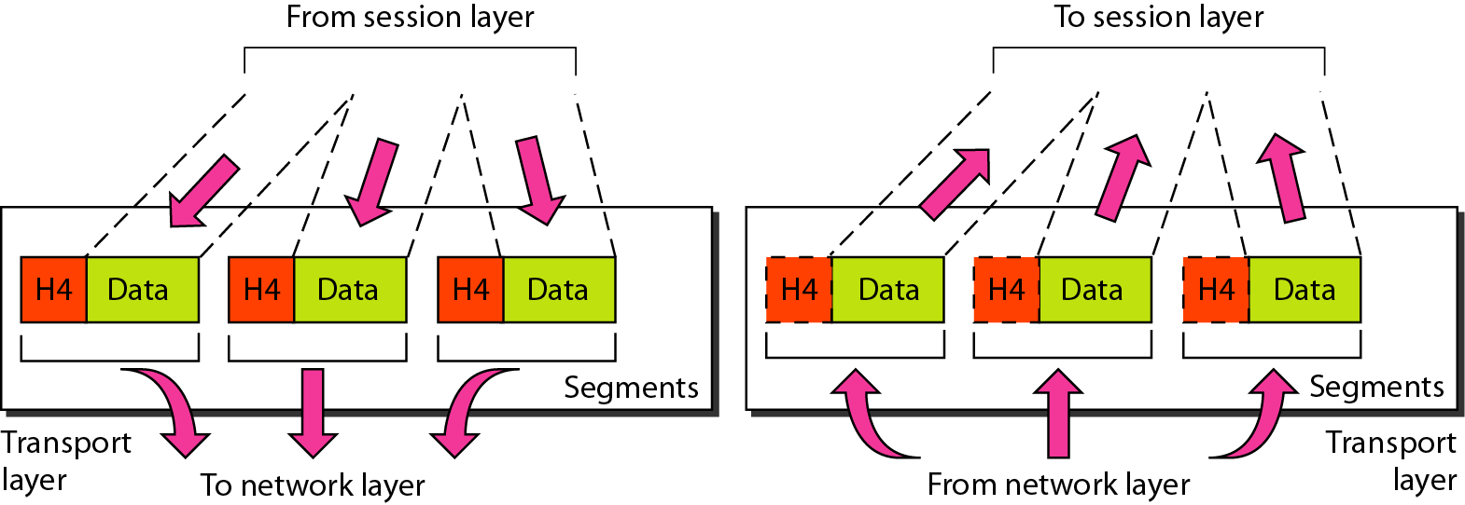
OSI Model: Layers: Transport Layer
The transport layer is responsible for the delivery of a message from one process to another.

Slide 41
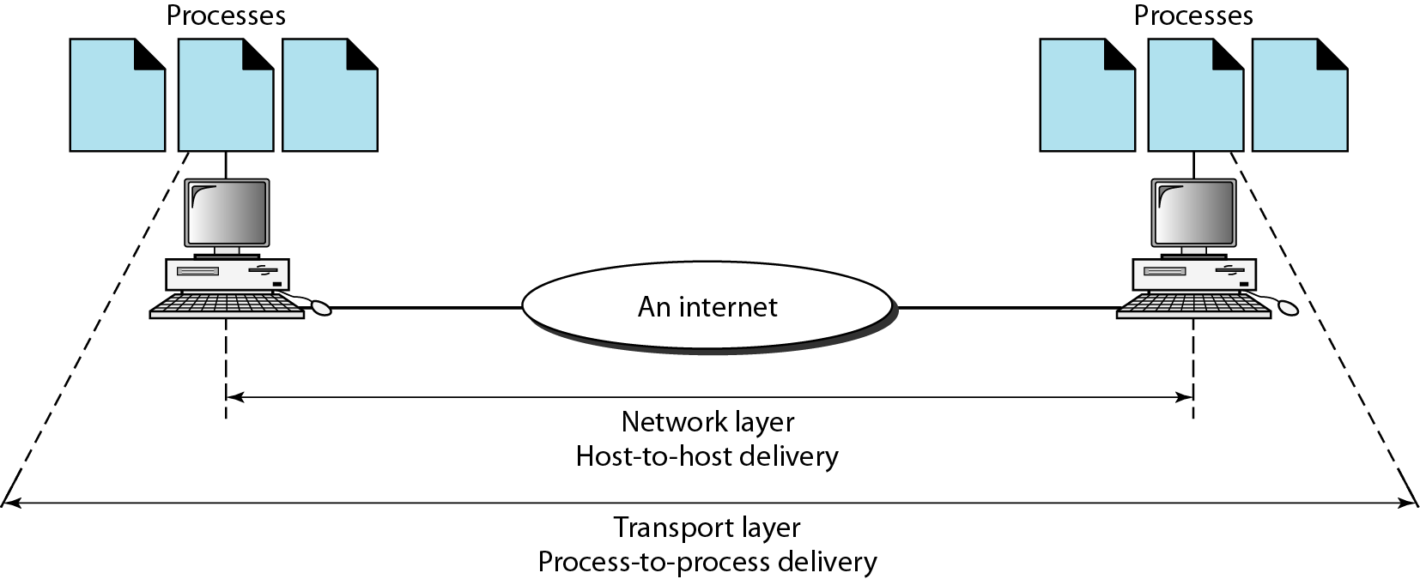
OSI Model: Layers: Transport Layer
Reliable process-to-process delivery of the message

Slide 42
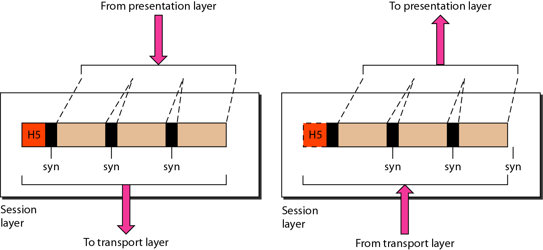
OSI Model: Layers: Session Layer
The session layer is responsible for dialog control and synchronization.

Slide 43
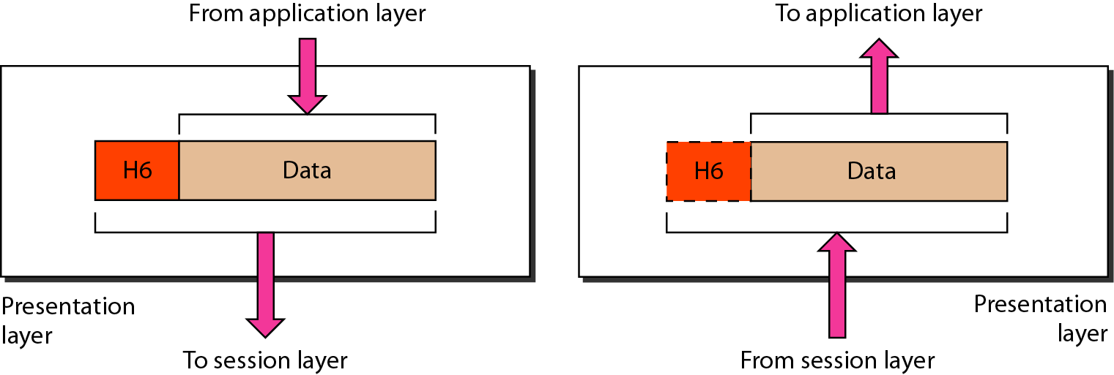
OSI Model: Layers: Presentation Layer
The presentation layer is responsible for translation, compression, and encryption.

Slide 44
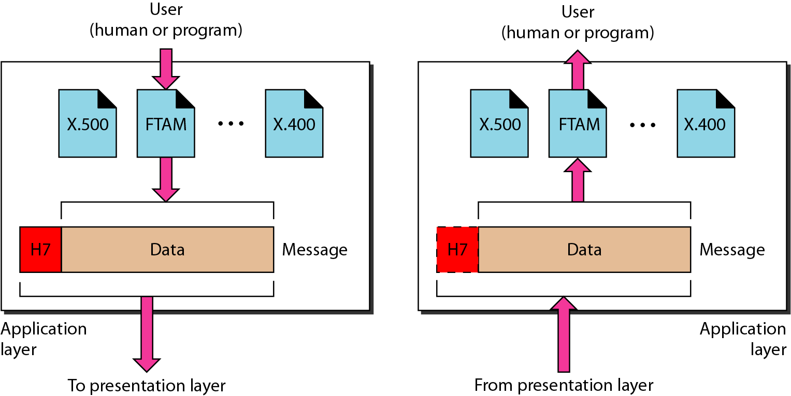
OSI Model: Layers: Application Layer
The application layer is responsible for providing services to the user.

Slide 45
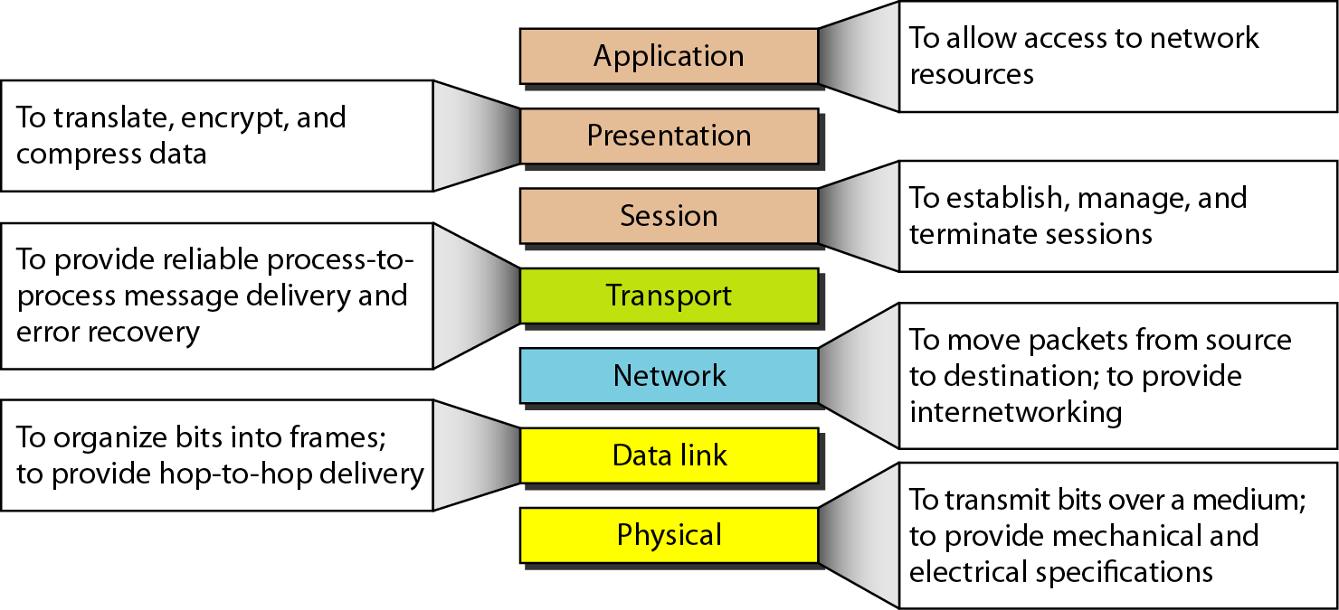
OSI Model: Summary of Layers

Slide 46
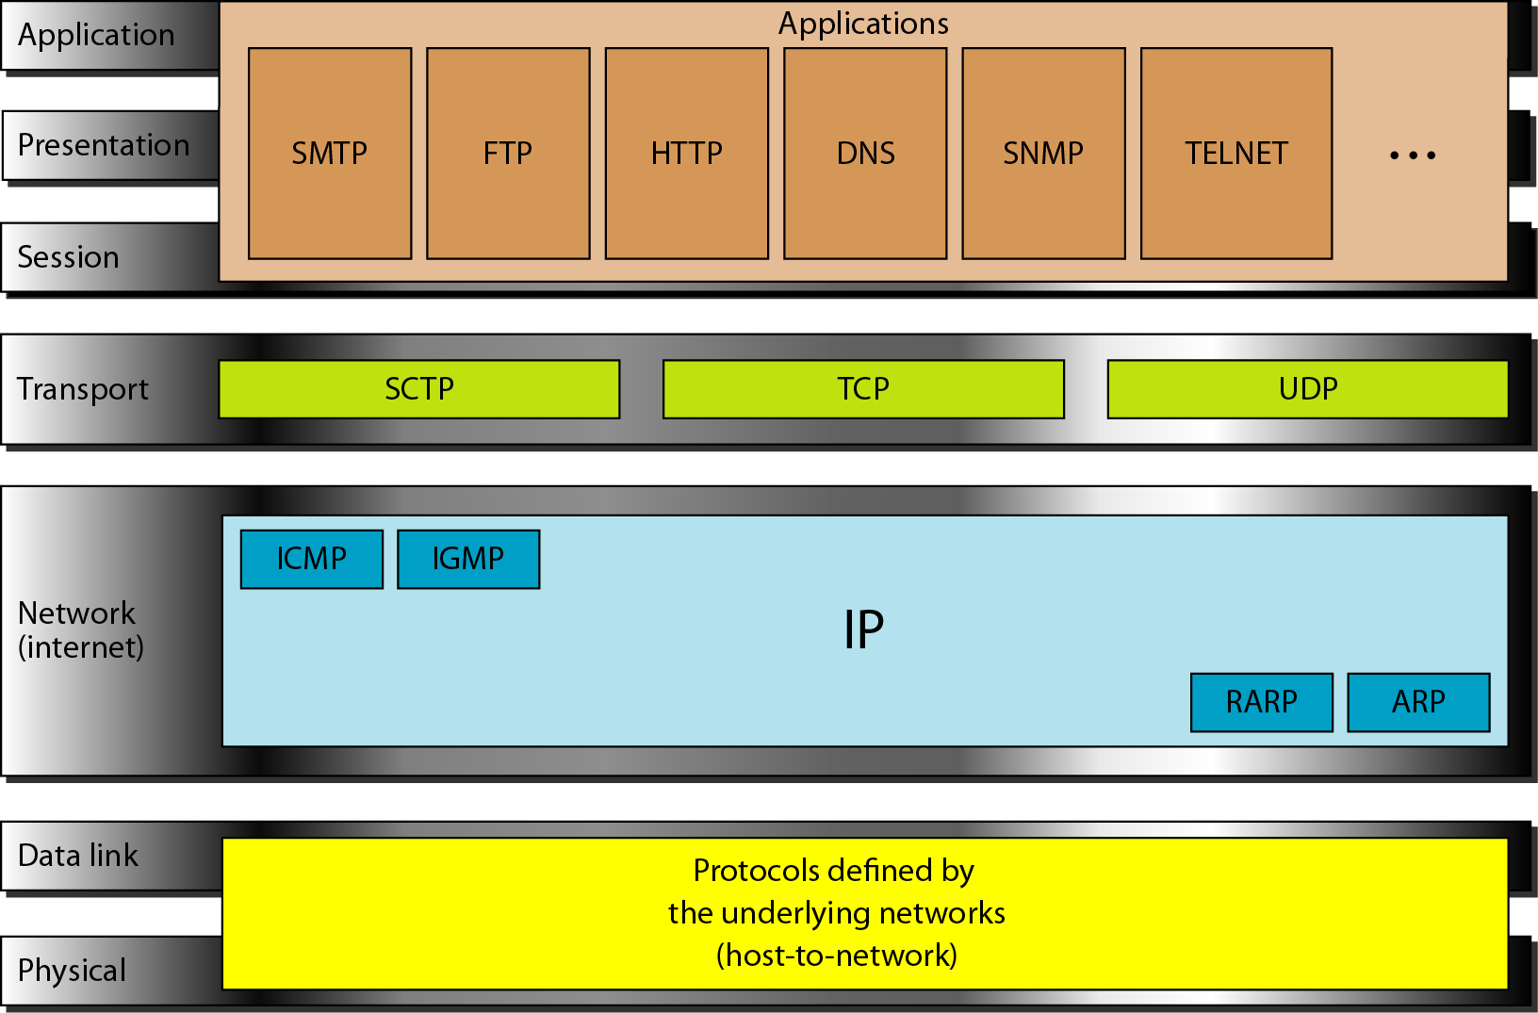
OSI Model: TCP/IP and OSI

Slide 47
OSI Model: Lack of OSI Model’s Success
OSI was completed when TCP/IP was fully in place
Lot of time and money had been spent on the suite
Some layers in OSI were never fully defined
OSI was implemented by an organization in a different application,
Didn’t show high enough performance to switch from TCP/IP to OSI

Slide 48
Thank you!!!
Questions are always welcome….

